Slide 1
Regression
Deepayan Chakrabarti (deepay@utexas.edu)

Slide 2
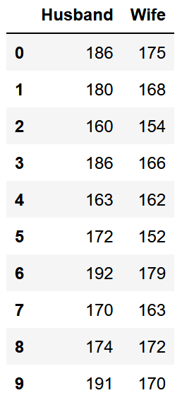
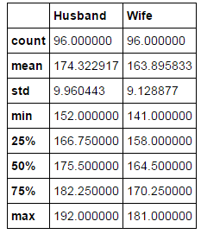
Simple linear regression
Let’s start with an innocuous question:
Do taller husbands have taller wives?
df.describe()
Paired observations
Summary statistics

Slide 3
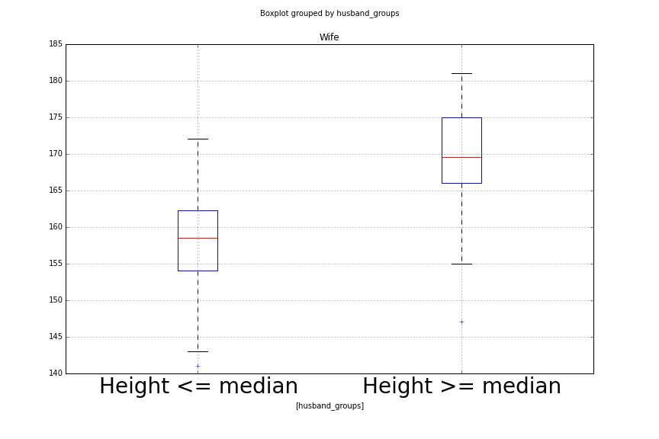
Simple linear regression
Let’s start with an innocuous question:
Do people of similar heights tend to marry each other?
Mean wife heights
First idea:
Group husbands into short and tall
Plot the heights of the wives of each group
Are wives of the tall-husband group taller than the wives of the short-husband group?

Slide 4
Simple linear regression
Let’s start with an innocuous question:
Do people of similar heights tend to marry each other?
Mean wife heights
Advantages
Simple: just measure the difference between mean wife heights
Disadvantages
Throws away a lot of information!
Why only two groups?

Slide 5
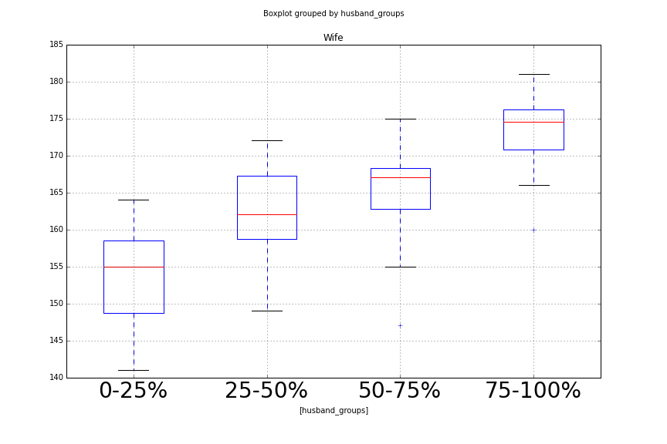
Simple linear regression
Let’s start with an innocuous question:
Do people of similar heights tend to marry each other?
Four groups of husbands

Slide 6
Simple linear regression
Let’s start with an innocuous question:
Do people of similar heights tend to marry each other?
Advantages
More fine-grained
Disadvantages
What do we measure now?
How do we conclude that wives also get taller alongside husbands?
Four groups of husbands

Slide 7
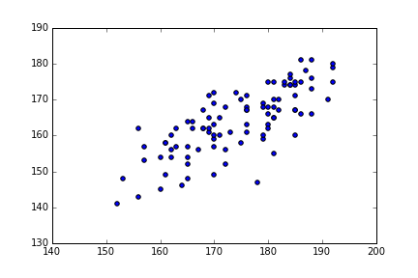
Simple linear regression
Let’s start with an innocuous question:
Do people of similar heights tend to marry each other?
Idea 2
Try to find a linear relationship between heights
Wife’s height
Husband’s height

Slide 8
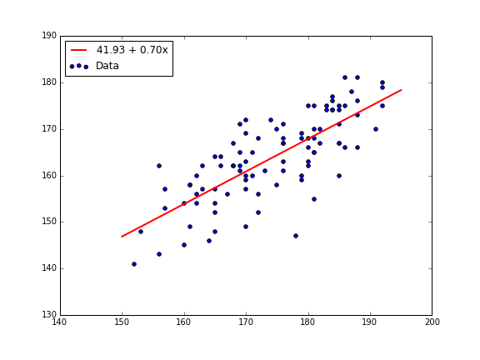
Simple linear regression
Let’s start with an innocuous question:
Do people of similar heights tend to marry each other?
Idea 2
Try to find a linear relationship between heights
Wife’s height
Husband’s height
Wife’s height = 41.93 + 0.70 * husband’s height

Slide 9
Simple linear regression
Let’s start with an innocuous question:
Do people of similar heights tend to marry each other?
Slope is positive ➔ positive association in heights
Wife’s height = 41.93 + 0.70 * husband’s height
Intercept
Slope

Slide 10
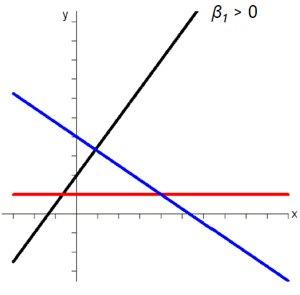
Slope and intercept
The equation of a line: y = β₀ + β₁ x
The slope β₁ is the rate of change
The sign of β₁ matters!
β₁ = 0: no association
β₁ > 0: positive association
β₁ < 0: negative association
β₁ > 0
β₁ = 0
β₁ < 0

Slide 11
Finding the best fit
Why choose this particular slope and intercept?
The data isn’t exactly a line
we just took the “best fit” line
What does “best fit” mean?
Related to the concept of the “outlier”
Wife’s height
Husband’s height

Slide 12
Finding the best fit
Wife’s height
“Error” for this point
Husband’s height

Slide 13
Finding the best fit
Given husband’s height = x, what is wife’s height y?
We expect:
y_{exp} = 41.93 + 0.70 * x
We observe:
some other y_{true}
Error = (y_{true} – y_{exp})²
The “best fit” line is the one that minimizes the sum of all errors
Wife’s height
“Error” for this point
Husband’s height

Slide 14
Finding the best fit
Why pick this particular formula?
Error = (y_{true} – y_{exp})²
because...
history
mathematical convenience
a belief that errors are “distributed” as a bell curve
but alternate formulas are also used
and there are many of them!

Slide 15
Goodness of fit
Suppose we are told of a husband’s height (say, 170cm)
Predict wife’s height
41.93 + 0.70 * 170 = 161cm
Wife’s height
Husband’s height

Slide 16
Goodness of fit
Thanks to regression:
We can predict wife’s height given husband’s height
Slope = 0.7 > 0 ➔ positive association
Should we believe these two statements?
Wife’s height
Husband’s height

Slide 17
Goodness of fit
Thanks to regression:
We can predict wife’s height given husband’s height
Slope = 0.7 > 0 ➔ positive association
Should we believe these two questions?
These are different questions
Wife’s height
Husband’s height

Slide 18
Goodness of fit
For predictions
the noise around the best fit line matters
captured by a statistic called R²
Wife’s height
Husband’s height

Slide 19
Goodness of fit
For predictions
the noise around the best fit line matters
captured by a statistic called R²
High-level idea:
R² compares the regression prediction to just predicting the mean
Calculate (y_{true} – y_{pred})², and sum it up ➔ the residual
Calculate (y_{true} – mean)², and sum it up ➔ the total variance
R² = 1.0 - ratio of the residual to the total variance
R² is between 0 and 1
Higher is better

Slide 20
Goodness of fit
To check if the positive association really exists or not
we are just asking: are we sure the slope is > 0?
captured by another statistic called the p-value
Wife’s height
Husband’s height

Slide 21
Goodness of fit
To check if the positive association really exists or not
we are just asking: are we sure the slope is > 0?
captured by another statistic called the p-value
Main idea:
What are the chances that there really is no association, and
we just see positive association due to “randomness”?
Smaller values are better
You may want it to be less than 0.05

Slide 22
Goodness of fit
R² and p-value measure different things!
All points on line ➔ R² = 1.0 but not sure of positive association ➔ large p-value
Points are far from line ➔ R² is small
but clearly positive association ➔ small p-value

Slide 23
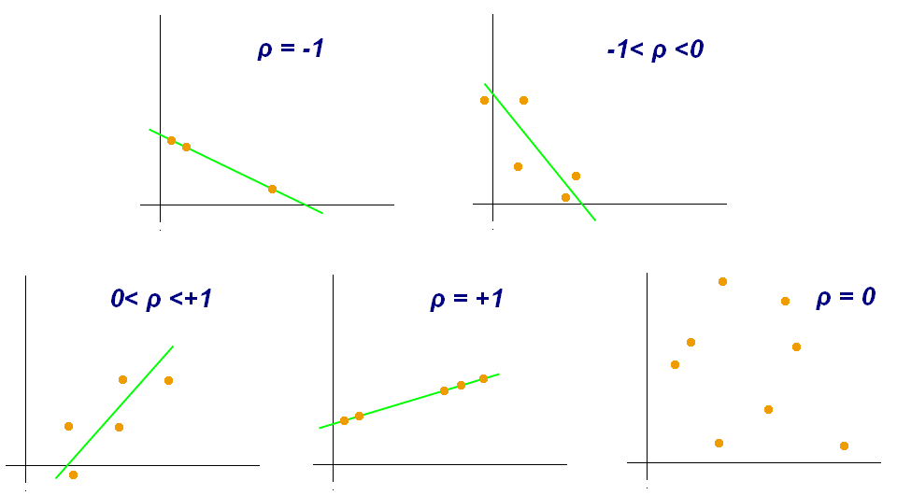
Relationship to correlation
Recall that the correlation coefficient also measured the degree to which the data fits a line
[Wikipedia]

Slide 24
Relationship to correlation
Recall that the correlation coefficient also measured the degree to which the data fits a line
But linear regression is also trying to fit a line
The R² statistic tries to measure just this goodness of fit
Are they related?
Very closely!
R² = square of the correlation coefficient
-1 <= Correlation <= 1
0 <= R² <= 1

